Slide 1















Supporting Australian Adopting Families
Relationships Australia
Presented by Hannah, Isla and Michael

Slide 2

Introduction
Providing support services
(Relationships Australia Victoria, 2024)
Adoption families and intercountry adoption​
Challenges faced
Isla, Hannah and Michael
2
Notes:
I’m Michael, and this is Hannah and Isla. We investigated the issues related to adoption families in Australia, particularly intercountry adoptions. We examined the way in which our chosen organisation of Relationships Australia uses their Intercountry Adoptee and Family Support Services program to address the challenges they face. Throughout our presentation, we will discuss the services offered by the organisation, the models of family theory and responsible practice that are utilised, and the benefits for adoption families in terms of health and wellbeing. References are provided at the end of the presentation.

Slide 3

Aims & Missions
Relationships Australia aims to support families who have undertaken an intercountry adoption or been adopted, through the challenges that may arise (Relationships Australia Victoria, 2024).
(raisingchildren.net.au, 2006)
Isla
3
Notes:
The aim of Relationships Australia is to provide families in Australia with free, confidential supports surrounding their intercountry adoption. Relationships Australia provides this support to the adoptees, their families and includes both child and adult adoptees, the adoptive parents, adoptees family or anyone going through the intercountry adoption process.
Intercountry adoptions comes with its own set of unique challenges and complexities that can often be hard for families to undergo or cope with. Relationships Australia provides its services through the Intercountry Adoptee and Family Support Service (ICAFSS). This is delivered by Relationships Australia freely to Australians all across the nation (Relationships Australia Victoria, 2024).

Slide 4

Funding
Relationships Australia is funded by the Commonwealth of Australia (Relationships Australia Victoria, 2024).
Their funding is administered through the Australian Government Department of Social Services (Tebbey, 2022).
Isla
4
Notes:
Relationships Australia is able to provide its services to Australians for free due to its funding, the funding for Relationships Australia is provided by The Commonwealth of Australia and is administered more specifically by the Australian Government Department of Social Services (Tebbey, 2022).

Slide 5
Free services to Australians nationwide
01.
(Relationships Australia Victoria, 2024)
Strengths of Relationships Australia
Small grants and bursaries scheme
02.
(Relationships Australia Victoria, 2024)
03.
Individualised casework & personalised support
(Relationships Australia Victoria, 2024)
Isla
5
Notes:
Relationships Australia has many strengths, with its large range of diverse, catered supports for its users.
One of the main strengths that Relationships Australia holds, is that it provides support to these families in Australia at no cost, providing free services to all people who wish to use it means that everyone in Australia can not only afford the support they need but also not face discrimination based on their socioeconomic status, whether the individuals are considered financially stable or not. Compared to other therapies or groups that require payment, Relationships Australia services are available for at risk and struggling families going to hear from Michael who will talk to us about why Relationships Australia is an organisation that we need to help support Australian families in the intercountry adoption community.

Slide 6
The Issue
Child’s trauma of separation from their country of origin
Involvement of birth families
Unknown reasons for adoption
Parents were unable to conceive
(Relationships Australia Victoria, 2024)​
Michael
6
Notes:
Relationships Australia works with Adoptees and their families in addressing the fundamental trauma of adoption in itself introduced to adoptees.
Intercountry adoptees specifically deal with challenges around such issues as:
Identity and belonging
Grief, loss and trauma.
Peer connection.
Cultural identity and loss thereof.
Search and reunion with biological family members.
Parents too can require support around the raising of adoptees and coming to terms with the above factors, as well as individual events that may influence the child's development as a member of a blended family (many adoptees come from families or cultures different to those of their adoptive parents/families):
Parents may choose to adopt as they are unable to conceive their own children,
Both adoptee and/or biological siblings within the family may also require additional support around the addition of a new family member.

Slide 7

Prevalence in Australia
There were 208 adoptions in Australia in 2023. 28 of these were intercountry adoptions.
(Australian Institute of Health and Welfare, 2024)
Michael
7
Notes:
Of the 208 adoptions in 2023, 28 of these were intercountry adoptees. While this figure differs significantly from the peak of adoptions in the early to mid seventies (at just under 10,000 per year), the support on offer to adoptees and their immediate families through Relationships Australia is far more individualised to the client. As previously noted through the definition of the challenge, Relationships Australia has been able to specialise their focus on the circumstances around the adoptees experience in contrast to the lack of support offered in peak times.

Slide 8

The Issue & Family Theory
Family Development Theory is most relevant to the experience of Intercountry Adoptees.
Adopted children have significant emotional triggers throughout the 8 stages, which are often repeated.
Each stage can serve as a lifelong reminder of their origins and separation from their birth family.
(Cohen and Strong, 2021)
Michael
8
Notes:
The application of Family Development Theory is applicable here due to it's similarities with individual development, as well as its links to the development of the family unit. While this model offers a simplistic description of the development of a typical family, The 8 stages of development can be delayed, skipped or rearranged for an adoptee.
Further, any trauma addressed within counselling about the child's origins can be retriggered when the adoptee becomes a parent themselves, and indeed, if they become grandparents. The repetition of the cycle holds the risk of re-traumatising the adoptee at multiple lifestages beyond childhood.
As this cycle is repeated through the lifespan of the adoptee, the potential for the disruption of the cycle in later generations (delayed development, skipping of stages, other typical adult milestones) continues to misalign with others in the community that the adoptee is in contact with.
Now we will hear from Hannah.

Slide 9

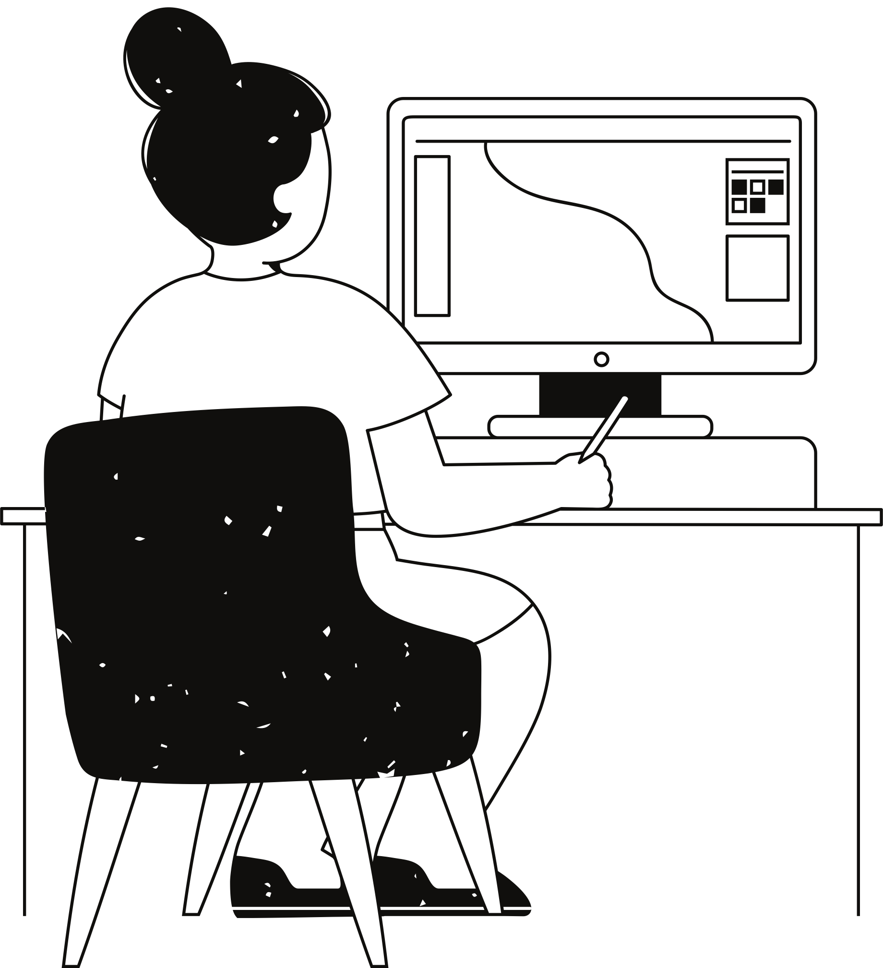







Individual and Family Counselling Services
Individual and Family Counselling Services
Therapeutic Groups and Parenting Support
Services
Referral to Other Services as Required
Education and Training for Allied Health Workers
Offered by Relationships Australia Intercountry Adoptee and Family Support Service
(Relationships Australia Victoria, 2024).
Case Management and Case Work Support
Small Grants
and Bursaries Schemes
Hannah
9
Notes:
The Relationships Australia Intercountry Adoptee and Family Support Service (ICAFSS) offers a range of services to support families throughout the adoption process. They utilise individual and family counselling, as well as therapeutic groups to allow for families to discuss their needs openly. Case management, casework support and parenting support ensure that families are given specified help to guide them through this time. Small grant and bursaries schemes ensure that families are financially supported. ICAFSS acknowledges that all families are diverse in terms of their needs and structures, and offers to refer families to other support services where it is required. Finally, allied health and community workers are trained by this service to be thoroughly prepared for the families and challenges they may encounter.

Slide 10

Responsible Practice
Relationships Australia’s Intercountry Adoptee and Family Support Service (ICAFSS) aligns its services with the Strengths-Based and Family-Centered Approaches
Strengths-Based Approach
Family-Focused Approach
Creating client-led goals through counselling and support groups (Devaney et al., 2022).
Sustainable change and referral to other services.
Each family is considered unique by trained allied health workers (Department of Social Services, 2022b).
Assisting diverse family structures after adoption.
Prepared with a range of services, and ready to refer.
Families need allies and supporters – this is offered with trained professionals and support groups (Department of Social Services, 2022a).
Hannah
10
Notes:
Relationships Australia’s ICAFSS offers services that align with both a strengths-based approach and a family-focused approach.
A strengths-based approach is one used by practitioners to examine the strengths of families or communities, and to develop resources to resolve problems that may arise (Devaney et al., 2022). As per the Department of Social Services (2022b), the strengths-based approach ensures that clients develop their own goals, which ICAFSS upholds through counselling and support groups that align with the family’s strengths. Through individual and family counselling, clients gain an understanding of their strengths and how to manage the post-adoption challenges. ICAFSS focuses on facilitating instead of fixing through their therapeutic groups, enabling family members to recognise their own practical and sustainable solutions. Counselling services and therapeutic groups with other families offered also give them hope and motivation. Through the education and training provided to allied health workers, they are aware of the language they should use (Department of Social Services, 2022b) to prompt families to work on their strengths and develop solutions to their challenges.
The family-focused approach is also used by ICAFSS and ensures that families identify their needs and make decisions together (Department of Social Services, 2022a). Inherently, ICAFSS recognises that all families are different by dealing with the unique family structures involved in adoption families. Through counselling and therapeutic services, ICAFSS supports families’ unique experiences by listening and assisting them with developing solutions. By offering grants, bursaries, support groups and case management services, ICAFSS ensure their family-focused approach by protecting the safety of children throughout the adoption process. Families are supported by other parents in their groups, and trained health workers who assist them during their adoption experience.

Slide 11

Promoting Health & Wellbeing
Adoption services led to improved mental health, self-esteem and knowledge about adoption (Dhami et al., 2007).
Improving child, parent and peer relationships. Encouraging reflection, improving support abilities (Kambouri et al., 2024).
Empowering families and increasing parental self-care, and validating challenges (Penner, 2023).
(DeGarmo, 2020)
Hannah
11
Notes:
ICAFSS ensures the promoting of family health and wellbeing as their support and clinical services ensure a range of improvements to mental health, self-reflection, and general awareness of adoption-related issues (Dhami et al., 2007). Post adoption services are associated with reduction in stress regarding the process, and assist with managing the children’s behavioural and emotional issues (Dhami et al., 2007). ICAFSS has the capacity to improve child, parent and peer relationships, by increasing awareness and communication. All individuals involved are offered practical strategies to coping with challenges, helping parents to understand their children on a more sensitive level (Kambouri et al., 2024). Families are empowered by these services to reflect on their needs, and therefore become a more stable support system for their children (Kambouri et al., 2024). These services are crucial in prompting parental self-care, as involved professionals validate family challenges as children heal from trauma they may have experienced (Penner, 2023). We will now hear from Isla.

Slide 12
Conclusion
Invaluable services for adopting families
Assisting adoptive families and adoptees in need ​
Government Funding
Unique asset for directory services for families in need of support
Isla and Hannah
12
Notes:
Relationships Australia can be seen as a prominent support to families who are attempting to navigate the issues that can be found when it comes to intercountry adoption. Through its government funding, Relationships Australia offers many services that are considered invaluable and are specifically aimed at adoptive families and adoptees themselves.
Using strengths based and family focused approaches, they empower their users to work through the issues they are facing. By offering a diverse range of supports, both financial, practical and psychological, Relationships Australia, provides reliable guidance nationwide. Hence, it should be considered as a valuable asset for directory services for families in need of support due to its unique ability to support families throughout the entire adoption process.
Thank you for your listening to our presentation, feel free to ask any questions at all.

Slide 13
References
Australian Government Department of Social Services. (2022, May 5). Children and Family Intensive Support (CaFIS). Retrieved from Child-Centred, Family-Focused Support: https://www.dss.gov.au/families-and-children-programs-services-parenting-families-and-children-activity/cafis-1b-child-centred-family-focused-support
Australian Government Department of Social Services. (2022, May 5). Strengths-Based Approach. Retrieved from Children and Family Intensive Support (CaFIS): https://www.dss.gov.au/families-and-children-programs-services-parenting-families-and-children-activity/cafis-1h-strengths-based-approaches
Australian Institute of Health and Welfare. (2024, March 13). Adoptions. Retrieved from Australian Government - Australian Institute of Health and Welfare (AIHW): https://www.aihw.gov.au/reports-data/health-welfare-services/adoptions/overview
Cohen, T.F. and Strong, B (2021). The Marriage and Family Experience: Intimate Relationships in a Changing Society, Fourteenth Edition. Cengage Learning.
DeGarmo, J. (2020). Happy Couple with Adopted Daughter [Online Image]. In Medium . https://drjohndegarmo.medium.com/10-truths-you-need-to-know-about-adoption-a4cfa4bfb6ab
Devaney, C., Brady, B., Crosse, R., & Jackson, R. (2023). Realizing the potential of a strengths-based approach in family support with young people and their parents. Child & Family Social Work, 28(2), 481-490. https://doi.org/10.1111/cfs.12978
Hannah, Isla and Michael
13

Slide 14
References
Dhami, M. K., Mandel, D. R., & Sothmann, K. (2007). An evaluation of post-adoption services. Children and Youth Services Review, 29(2), 162-179. https://doi.org/10.1016/j.childyouth.2006.06.003
Intercountry Adoptee and Family Support Service. (2020). Small Grants and Bursaries Guideline (pp. 1–5). Intercountry Adoptee and Family Support Service. https://www.communitygrants.gov.au/sites/default/files/documents/2022-06/3554-icafss-small-grants-and.pdf
Kambouri, M., Curtis, F., Dimitriadi, Y., Ravenhill, M., & Coleman, L. (2024). Exploring the Benefits and Challenges of a Support Service for Adoptive Parents: A Case Study of Evaluating the Adopter Champions Programme. Open Journal of Social Sciences, 12(3), 437-469. https://doi.org/10.4236/jss.2024.123029
Penner, J. (2023). Post-Adoption Services Provision: A Scoping Review. Adoption Quarterly, 1-30. https://doi.org/10.1080/10926755.2023.2176957
raisingchildren.net.au. (2006). Intercountry Adoptive Fathers [Online Image]. In raisingchildren.net.au. https://raisingchildren.net.au/grown-ups/family-diversity/parents-like-me/raising-adopted-children
Relationships Australia Victoria. (2024). Intercountry Adoptee and Family Support Service. Retrieved from Relationships Australia Victoria: https://www.relationshipsvictoria.org.au/intercountry-adoptee-family-support-service/
Tebbey, N. (2022, January 28). Relationships Australia - Budget 2022-2023 - Public Consultation - Pre-Budget Submissions. Retrieved from Treasury.gov.au: https://treasury.gov.au/sites/default/files/2022-03/258735_relationships_australia.pdf
Hannah, Isla and Michael
14

